Slide 1
Ecommerce Capstone Project (Mid Submission)
Group Members:
Merin Jose
Suresh Balla
Deepak Aneja
Fayiz Mayam Veettil
23 Sep 2018

Slide 2
Table of Contents
Business Understanding
Data Understanding
Data Preparation
Modelling
Recomendations

Slide 3
Business Understanding
“ElecKart” is an e-commerce firm specializing in electronic products. They spent a significant amount of money in marketing and occasionally they offer big-ticket promotions as well. It take orders and delivers at door steps and deal with all major electronics product categories - Camera, Home Audio & Gaming Accessories
The money ElecKart spent over last 12 months on marketing was not sufficiently impactful. Now they want to create a marketing budget for the next year which includes spending on commercials, online campaigns, and pricing & promotion strategies and maximum revenue out of it.
The key objectives of the analysis are:
Develop a market mix model to observe the actual impact of different marketing variables over the last year
Recommend the optimal budget allocation for different marketing levers for the next year
Improve the revenue response either by cutting down the marketing budget or reallocating it optimally across marketing levers

Slide 4
Data Understanding
Around of 1.6 M records of Consumer Electronics data for the below three product sub-categories available for analysis
Camera Accessory
Home Audio
Gaming Accessory
It covers the data from July 2015 to June 2016
Other available datasets are
Media Investments
Special Sale Calendar
Monthly NPS Score

Slide 5
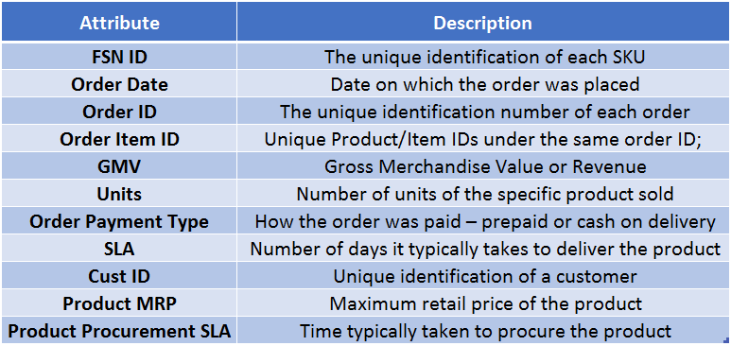
Data Understanding – Major Attributes
The data received for the analysis have 20 attributes. The important ones are -

Slide 6
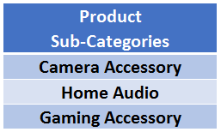
Data Understanding – Segmentation of Data
It covers the data from July 2015 to June 2016
Data is segmented by three major product sub-categories

Slide 7
Data Understanding – Additional Information
Following additional information also received apart from consumer data
Monthly spends on various advertising channels –
Monthly spends split by various medias types such as TV, Internet, Radio and Others
Days when there was any special sale –
Information about the special sale calendar
Monthly NPS score –
Net promote score by month

Slide 8
Step by Step Approach for Analysis
Cleaning and formatting data
Derive useful metrics out of data
Check the data density and correlations
Data Scaling
Splitting the data between train and test
Data Modeling
Conclusion

Slide 9
Exploratory Data Analysis – Data Cleaning
Check for possible data inconsistencies
Check for duplicate records
Check for NA values in the columns used for analysis
Check the period of the provided data
Status of data cleaning
Around 100K records found duplicated and removed from the dataset
Around 4K removed where Gross Merchandise Value is Null
Removed the data which are not in the period used for analysis
Below columns where removed after applying Near Zero Variances
units, product_analytics_super_category

Slide 10
Exploratory Data Analysis – Derived Metrics
Below the columns derived for further analysis
Offer Price = (Product MRP * Unit Sold) – Gross Merchandise Value or Revenue
Week Number, week number of the year ranging from 0-53 with Monday as first day of the week
Day, day of the month ranging from 0-31

Slide 11
Categorical Vs Numerical Variables
Below the list of categorical and numerical variables considered for further analysis
Categorical Variables
s1_fact.order_payment_type
product_analytic_category
product_analytic_sub_category
product_analytic_vertical
Year
Month
Numerical Variables
gmv
deliverybdays
deliverycdays
sla
pincode
product_mrp
product_procurement_sla
offer_price

Slide 12
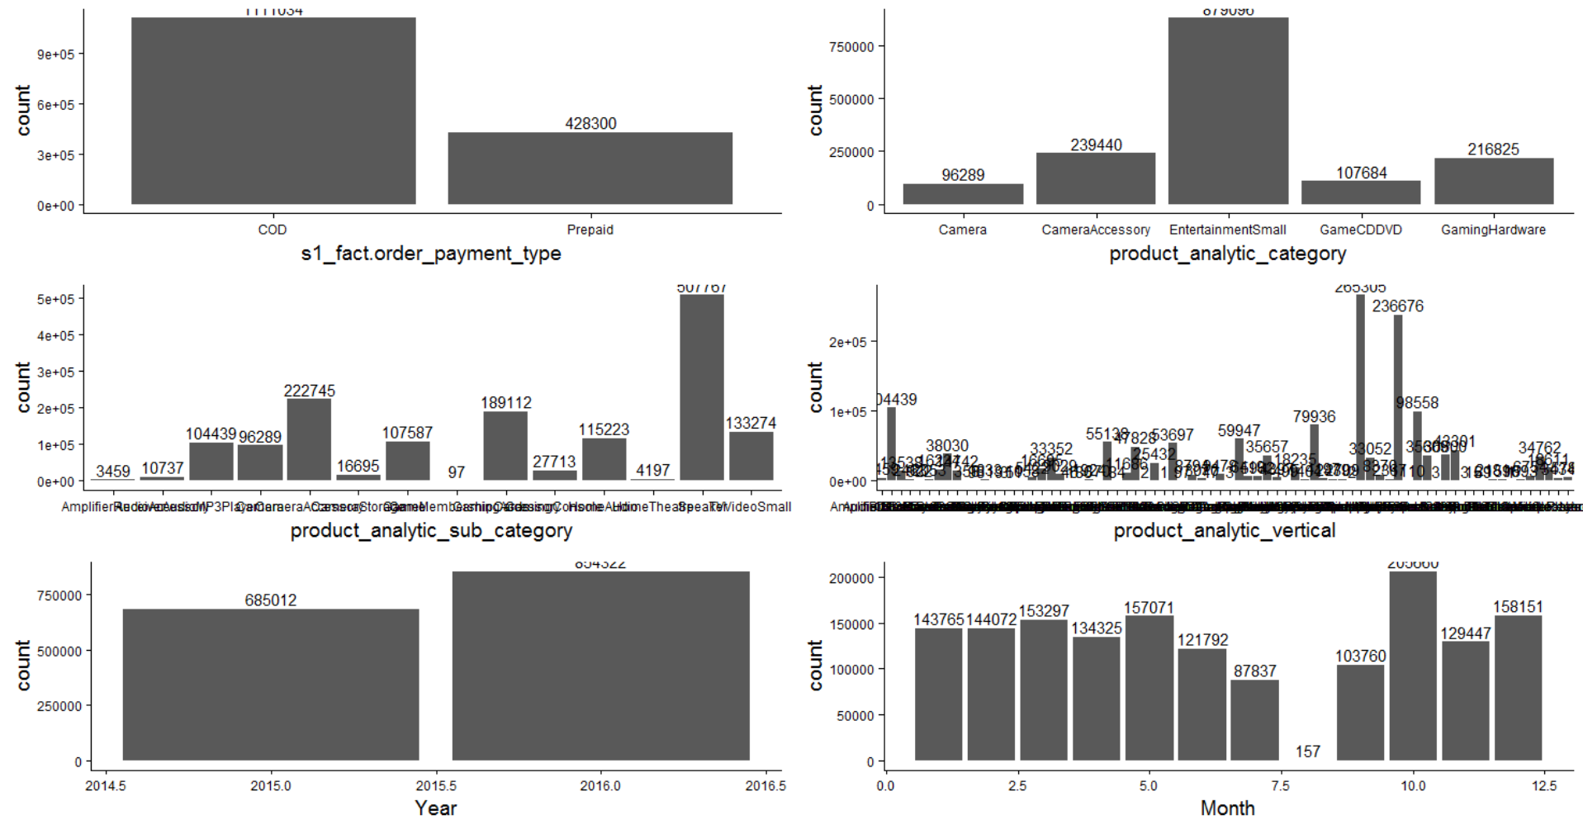
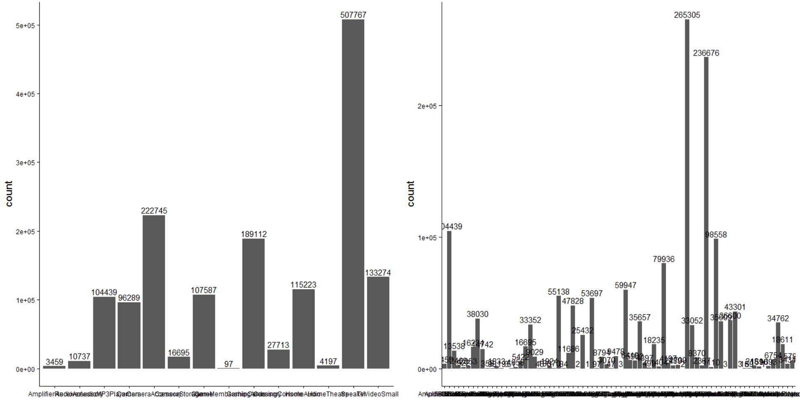
Univariate Analysis – Categorical Variables

Slide 13
Univariate Segmented Analysis – Numerical Variables

Slide 14
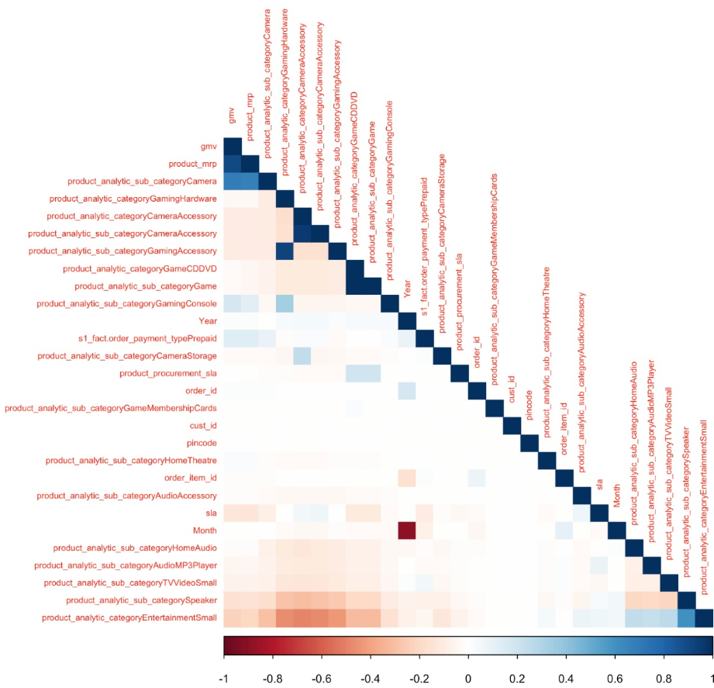
Bivariate Analysis – Correlation Plot

Slide 15
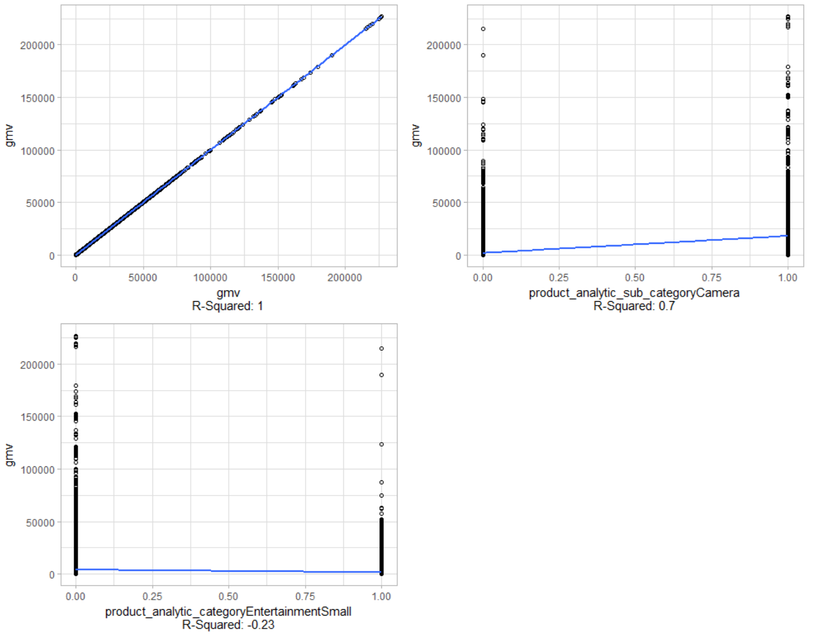
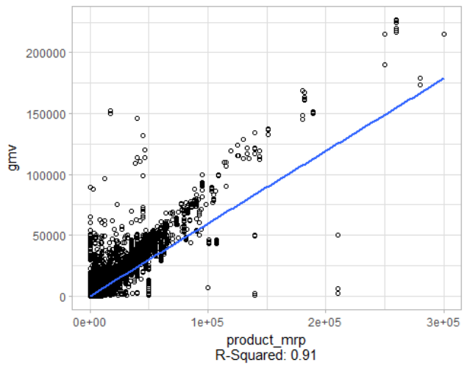
Bivariate Analysis – High Correlated Variables
Product_MRP,
SubCategory_Camera, Category_EntertainmentSmall
found high correlated to GMV

Slide 16
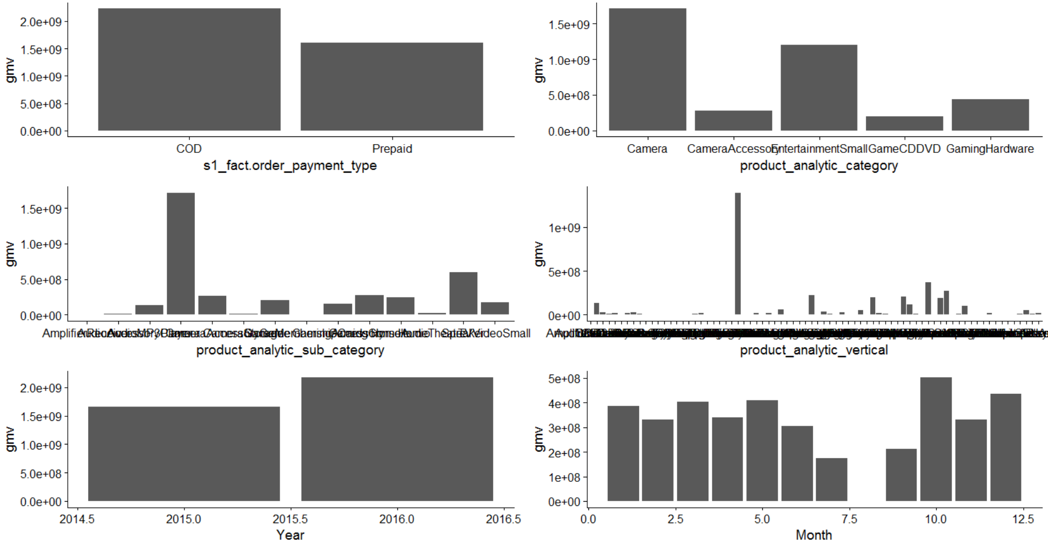
Aggregated Plots

Slide 17
Aggregation Strategy
Aggregate By day
Calculated the SUM of GMV, Product MRP and Offer Price variables
Aggregate By Month
Week Number, week number of the year ranging from 0-53 with Monday as first day of the week
Day, day of the month ranging from 0-31

Slide 18
Thanks
Merin Jose
Suresh Balla
Deepak Aneja
Fayiz Mayam Veettil

